Slide 1
TEAM P.E.O:
A Winning Menagerie

Slide 2

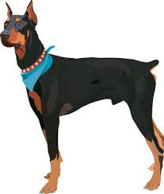
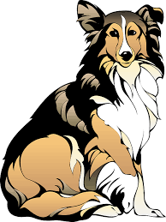
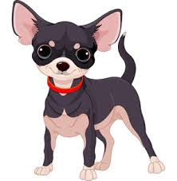
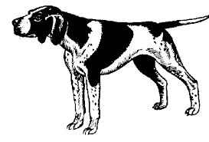

Are They a Team?
Sure, they’re all pedigreed, but are they a P.E.O. team?

Slide 3
Chart The Results
 | LION | OTTER | GOLDEN RETRIEVER | BEAVER
40 |  |  |  |  | 40
35 |  |  |  |  | 35
30 |  |  |  |  | 30
25 |  |  |  |  | 25
20 |  |  |  |  | 20
15 |  |  |  |  | 15
10 |  |  |  |  | 10
5 |  |  |  |  | 5
0 |  |  |  |  | 0

Slide 4



LION

Slide 5
LION
Born leaders
Accomplish/Immediate
Time frame = NOW
Decisive
Concise
Challenged by Questions
Not afraid of confrontation
Lions can be so strong that they win every verbal battle but end up losing the war for their friend’s and family’s hearts.

Slide 6
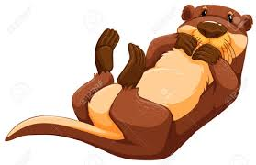

OTTER

Slide 7
OTTER
FUN!
Great Motivators
Details?
Future
No confrontation
Networking
Peer Pressure
Otters are excellent motivators. They can captivate an audience or encourage someone who is fainthearted.

Slide 8
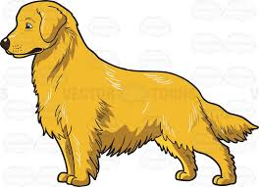
GOLDEN RETRIEVER

Slide 9

Golden Retriever
LOYAL
Needs close friends
Needs to please
Compassionate
Adaptable
Strong sense of Right
The same compassionate heart that can spot the hurt of others can be easily hurt by others as well.

Slide 10
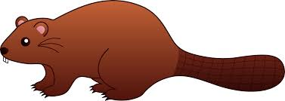
BEAVER

Slide 11
BEAVER
Monitor emotions
Read the instructions!
Careful
Critical thinkers
“Let’s do this right”
Internalize anger
Past
Beavers need to learn that it’s all right to fail and that it’s healthy to call for help when they’re struggling.

Slide 12
Likes authority……………………………………Too direct or demanding
Takes charge………………………………………Pushy; can step in front of others
Determined…………………………………………Overbearing
Confident……………………………………………Cocky
Firm…………………………………………………...Unyielding
Enterprising…………………………………………Takes big risks
Competitive………………………………………….Cold Blooded
Enjoys challenges………………………………….Avoids relations
Problem solver………………………………………Too Busy
Productive……………………………………………Overlooks feelings; do it now!
Bold……………………………………………………Insensitive
Purposeful; goal driven……………………………Imbalanced; workaholic
Decision Maker……………………………………...Unthoughtful of others’ wishes
Adventurous…………………………………………Impulsive
Strong willed………………………………………...Stubborn
Independent; self-reliant…………………………...Avoids people; seeking help
Controlling……………………………………….…...Bossy; overbearing
Persistent……………………………………………..Inflexible
Action oriented……………………………………....Unyielding
LIONS

Slide 13
Enthusiastic………………………………………......Overbearing
Takes risks……………………………………………Dangerous and foolish
Visionary………………………………………………Daydreamer
Motivator……………………………………………….Manipulator
Energetic……………………………………………….Impatient
Very verbal…………………………………………….Attacks under pressure
Promoter……………………………………………….Exaggerates
Friendly, mixes easily………………………………..Shallow relationships
Enjoys popularity……………………………………..Too showy
Fun loving……………………………………………...Too flippant; not serious
Likes variety……………………………………………Too scattered
Spontaneous…………………………………………..Not focused
Enjoys change…………………………………………Lacks follow through
Creative; goes for new ideas………………………..Too unrealistic; avoids details
Group oriented………………………………………….Bored with “process”
Optimistic………………………………………………...Doesn’t see details
Initiator……………………………………………………Pushy
Infectious laughter……………………………………..Obnoxious
Inspirational……………………………………………..Phony
O
T
T
E
R
S

Slide 14
Sensitive feelings………………………………………..Easily hurt
Loyal……………………………………………………….Misses opportunities
Calm; even keeled……………………………………….Lacks enthusiasm
Nondemanding…………………………………………...Weakling; pushover
Avoids confrontations…………………………………..Misses honest intimacy
Enjoys routine…………………………………………….Stays in rut
Dislikes change…………………………………………..Not spontaneous
Warm and relational……………………………………...Fewer deep friends
Gives in……………………………………………………..Co-dependent
Accommodating…………………………………………..Indecisive
Cautious humor…………………………………………...Overly cautious
Adaptable…………………………………………………...Loses identity
Sympathetic………………………………………………..Holds on to others’ hurts
Thoughtful………………………………………………….Can be taken advantage of
Nurturing……………………………………………………Ears get smashed
Patient……………………………………………………….Crowded out by others
Tolerant……………………………………………………..Weaker convictions
Good listener………………………………………………Attracted to hurting people
Peacemaker………………………………………………..Holds personal hurts inside
RETRIEVER S
GOLDEN

Slide 15
BEAVERS
Reads all instructions……………………………………..Afraid to break rules
Accurate……………………………………………………...Too critical
Consistent…………………………………………………...Lacks spontaneity
Controlled……………………………………………………Too serious
Reserved………………………………………………….….Stuffy
Predictable……………………………………………………Lacks variety
Practical……………………………………………………….Not adventurous
Orderly…………………………………………………………Rigid
Factual…………………………………………………………Picky
Conscientious………………………………………………..Inflexible
Perfectionistic………………………………………………..Controlling
Discerning…………………………………………………….Negative on new opportunities
Detailed………………………………………………………..Rarely finishes a project
Analytical………………………………………………………Loses overview
Inquisitive…………………………………………………..…Smothering
Precise…………………………………………………………Strict
Persistent………………………………………………………Pushy
Scheduled……………………………………………………..Boring
Sensitive……………………………………………………….Stubborn

Slide 16
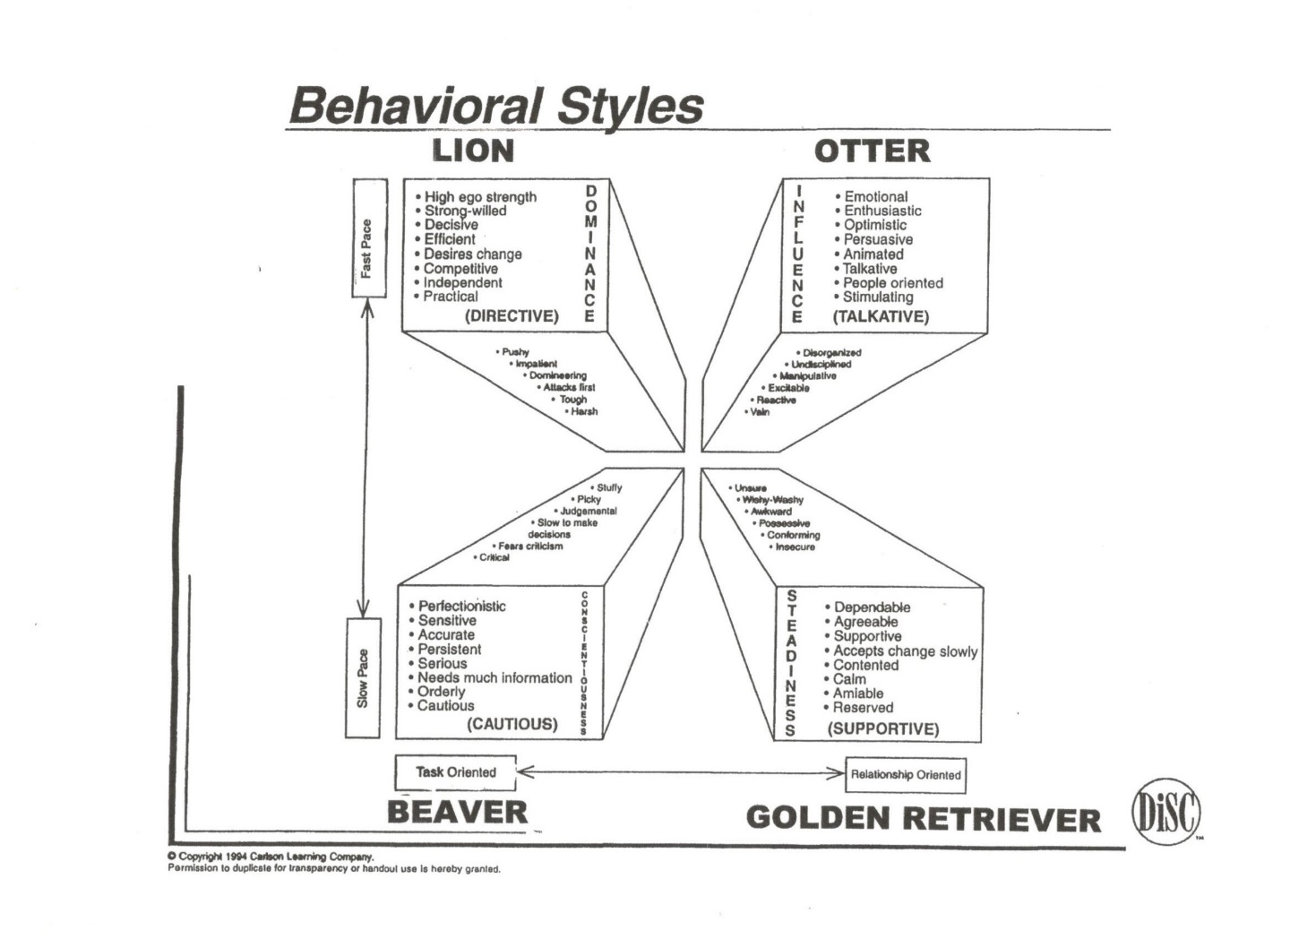

Slide 17
WHEN YOU FEEL UNDER
PRESSURE…
LION | Listen carefully and explain what you think
OTTER | Pause to assess the situation and check the facts
GOLDEN RETRIEVER | Take a risk to reach out and say what you think and feel
BEAVER | Interact with others and try to make a decision

Slide 18
BEHAVIORS UNDER PRESSURE
 | In Normal Situations | Under Pressure | Angry and Frustrated
LION | In Charge; Deciding | Bossy; Demanding | Leaves
OTTER | Persuading; Enthusiastic | Oversells; Attack others’ ideas | Gives in; May pout
GOLDEN RETRIEVER | Supportive; Friendly | Gives in | Hurt; Accuses
BEAVER | Careful; Quiet | Avoids; Can’t decide | Emotional; Attacks others

Slide 19
HOW TO GET ALONG BETTER
 | LION | OTTER | GOLDEN RETRIEVER | BEAVER
Behavior | Quick, likes short answers, like being in charge | Outgoing, likes to be with others, enthusiastic | Calm, likes to help others and get along, trustworthy | Quiet, likes to work alone, concerned with being correct
What they dislike | Being controlled by others | Working alone | Experiencing unhappy feelings with others | Having things be unclear or messy
How to get along better | Let them choose, be quick, don’t chatter | Do people things, talk about feelings, be enthusiastic | Keep things the same, cooperate, don’t get upset | Let them be right, hold back a bit, be logical

Slide 20
PERSONALITY MOTTO:
    LION
“Let’s Do It Now”

Slide 21
PERSONALITY MOTTO:
OTTER
“Trust Me! It’ll work out!

Slide 22
PERSONALITY MOTTO:
GOLDEN
RETRIEVER
“Let’s keep things the way they are!”

Slide 23
PERSONALITY MOTTO:
BEAVER
“How was it done in the past?”

Slide 24
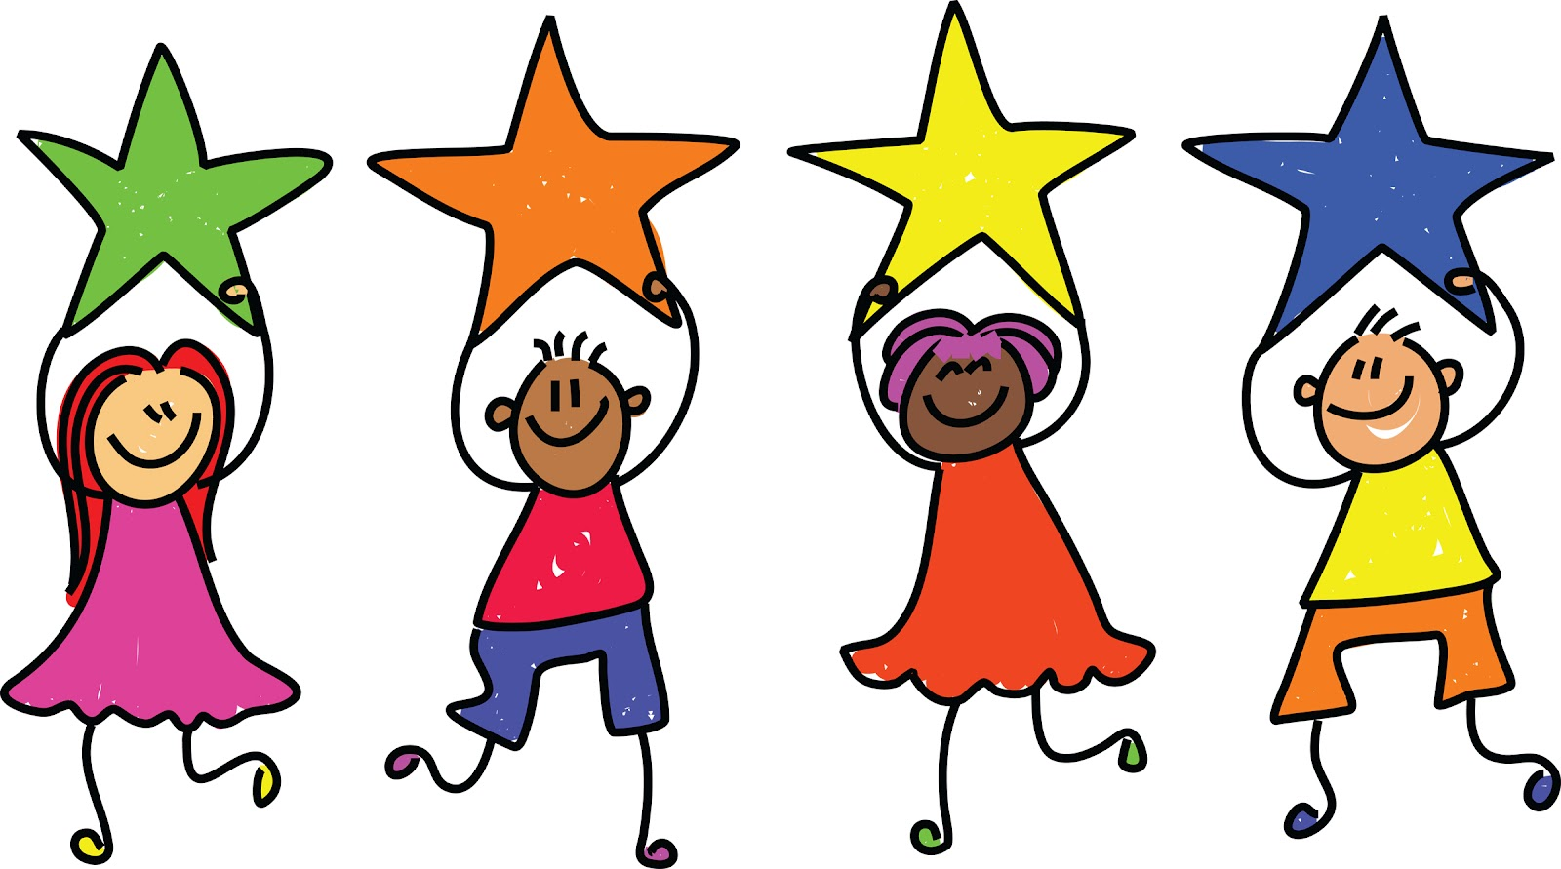
A P.E.O. Team is…
GOLDEN
RETRIEVER
LION
OTTER
BEAVER

Slide 25
A Winning P.E.O. Team is…
A group of people pooling its knowledge, skills, and talents to attain a common goal or shared purpose.

